Slide 1
Vision Transformers for Physics Prediction
Anthony Kalaydjian
4 July 2025

Slide 2
Agenda
01
Problem statement
02
Method
03
Experiments

Slide 3
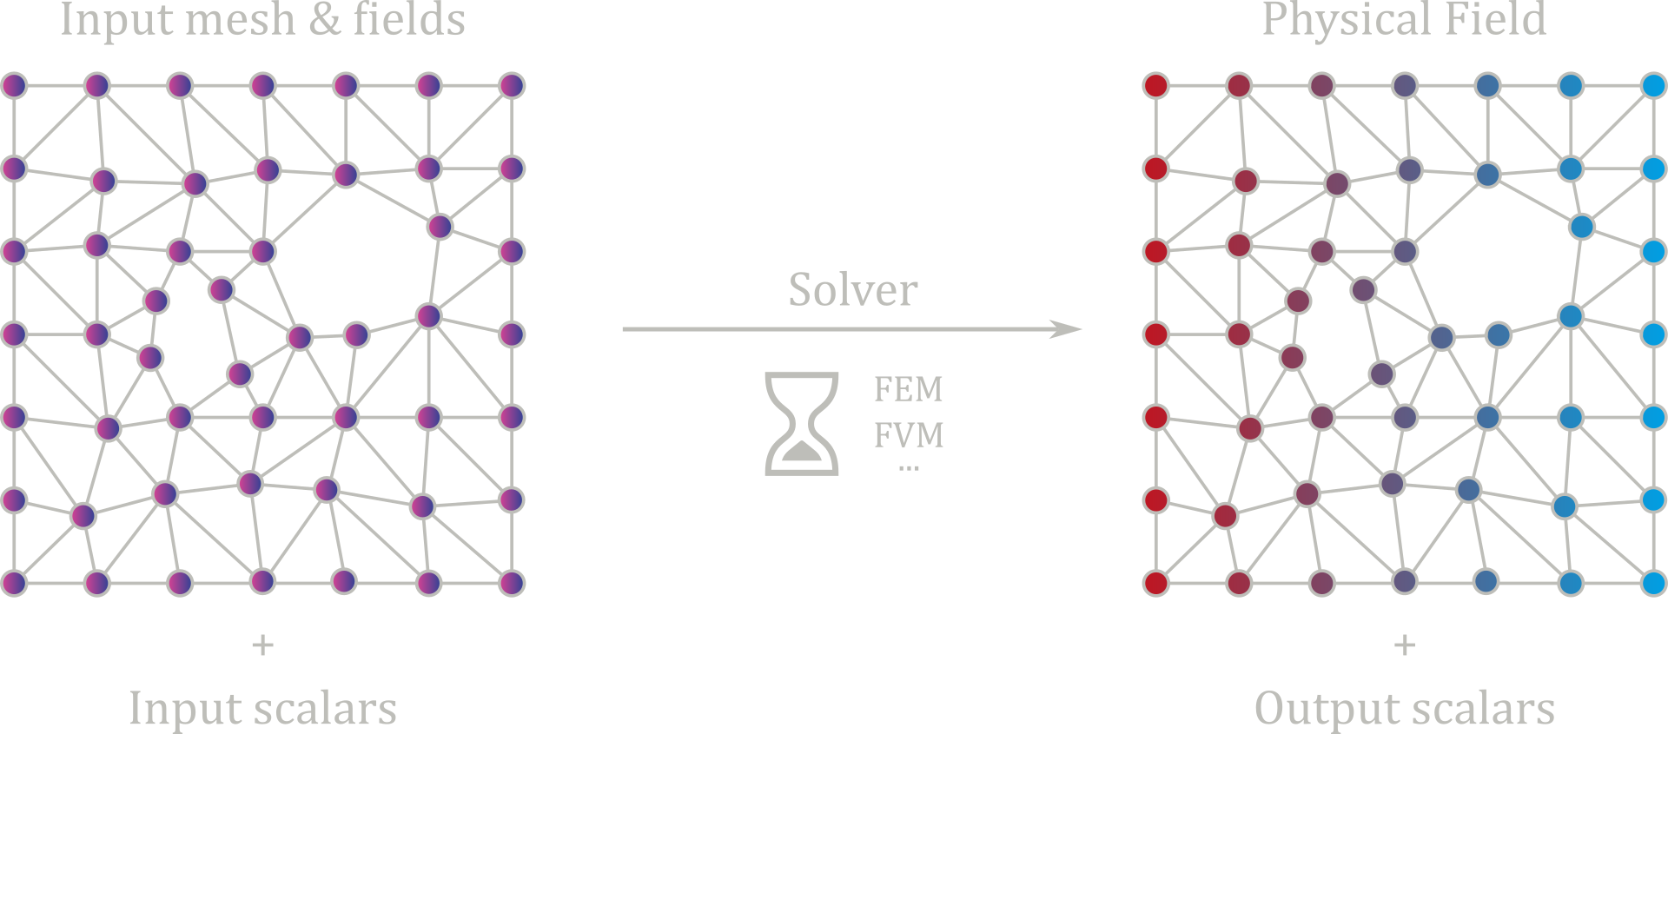
Problem statement
Safran usecase
Design (Aerodynamic shape optimization…)
Analysis
Surveillance

Slide 4
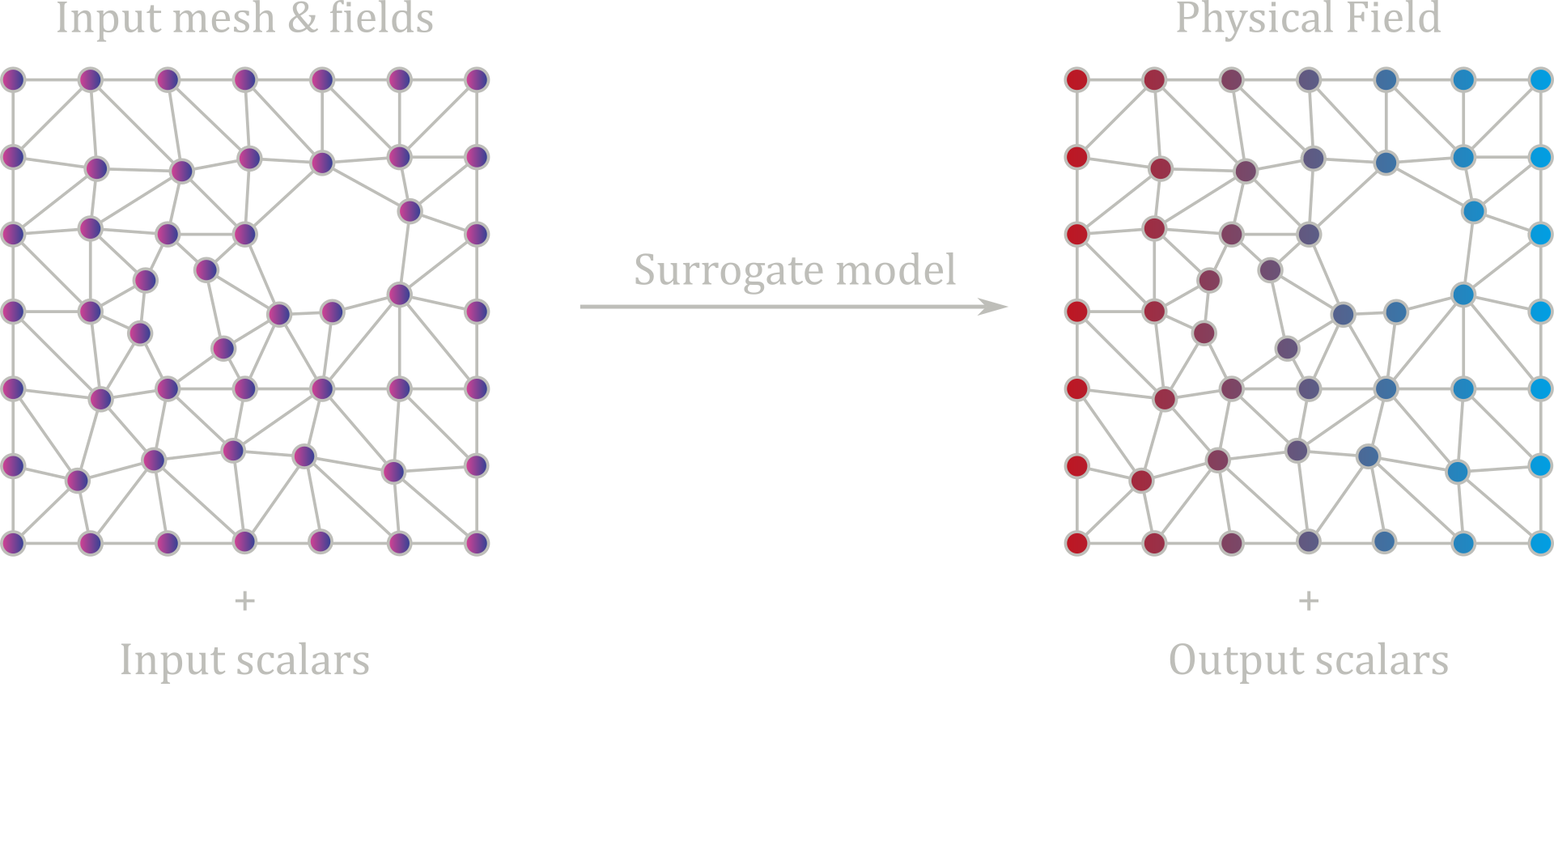
Problem statement

Slide 5
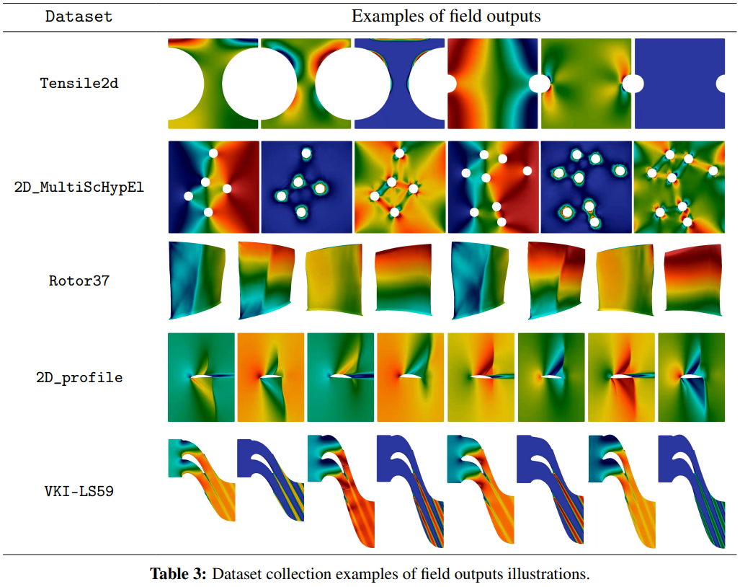


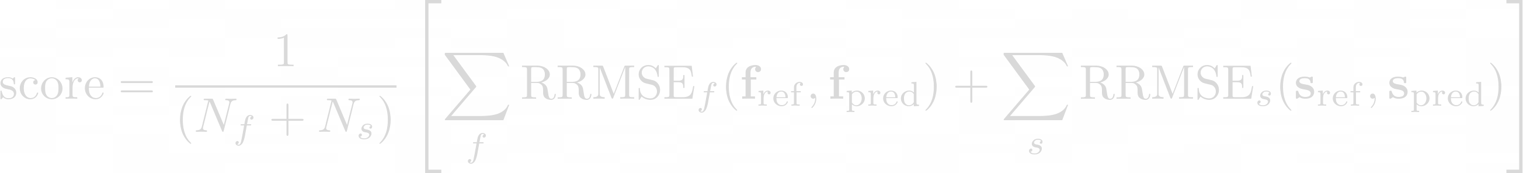
Problem statement
Evaluation
PLAID Benchmark

Slide 6
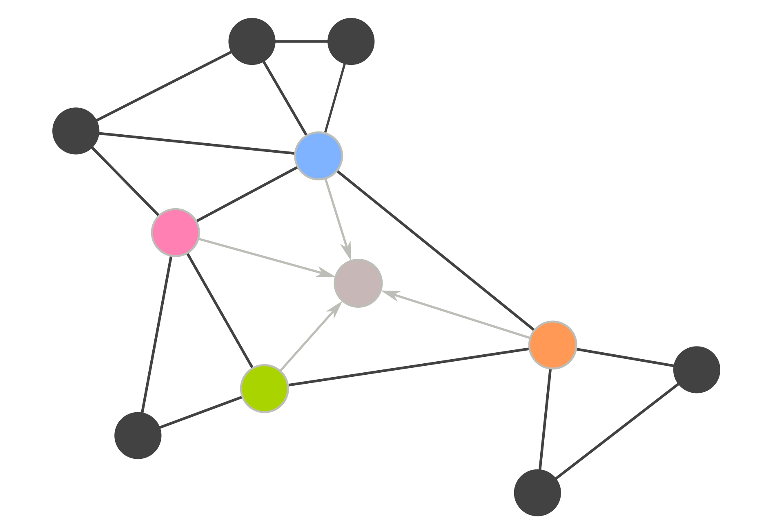
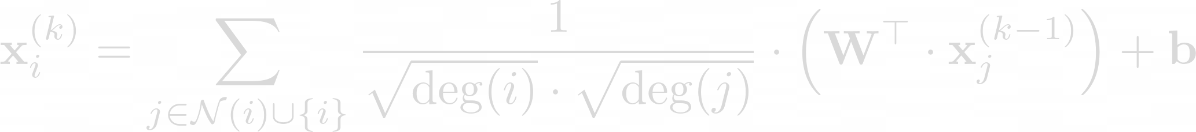
Problem statement

Slide 7
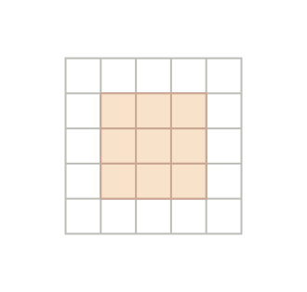
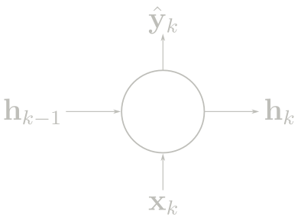
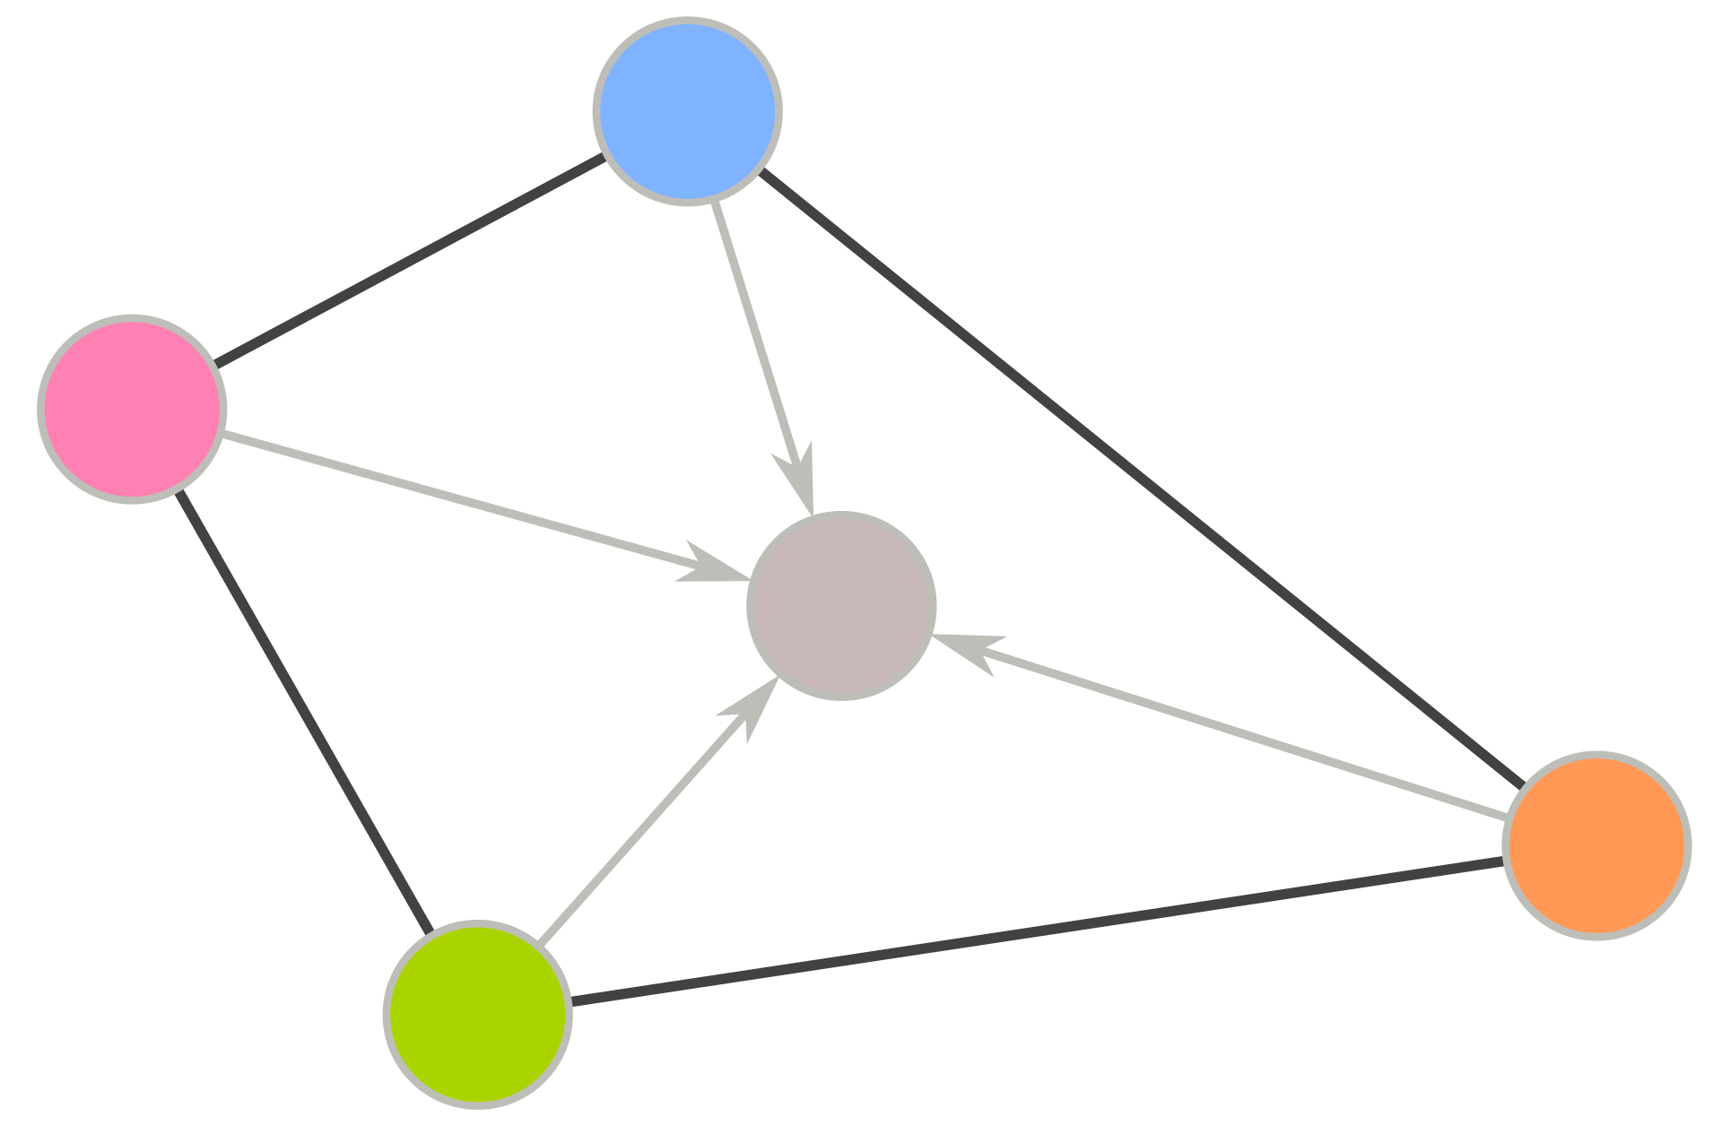
Problem statement
RNN
CNN
GNN

Slide 8
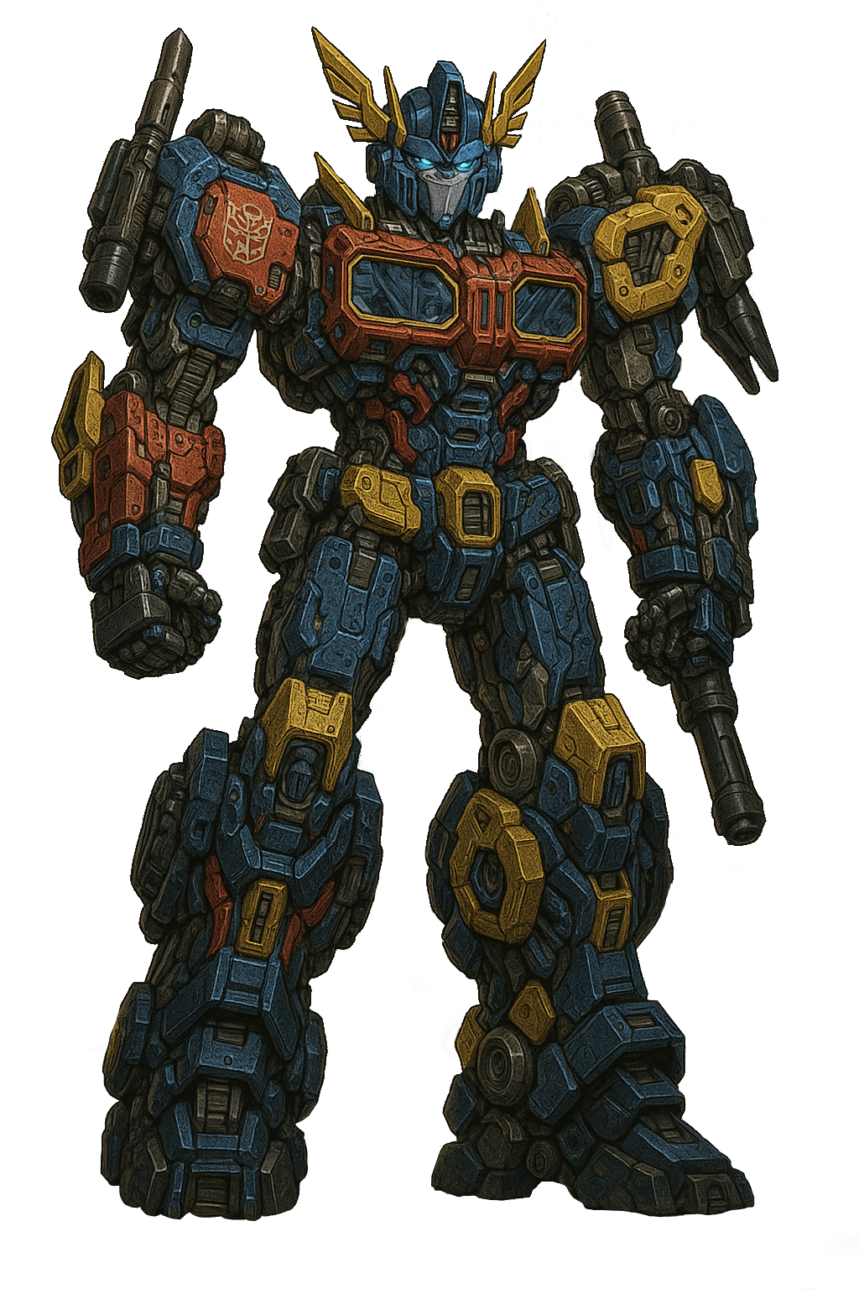
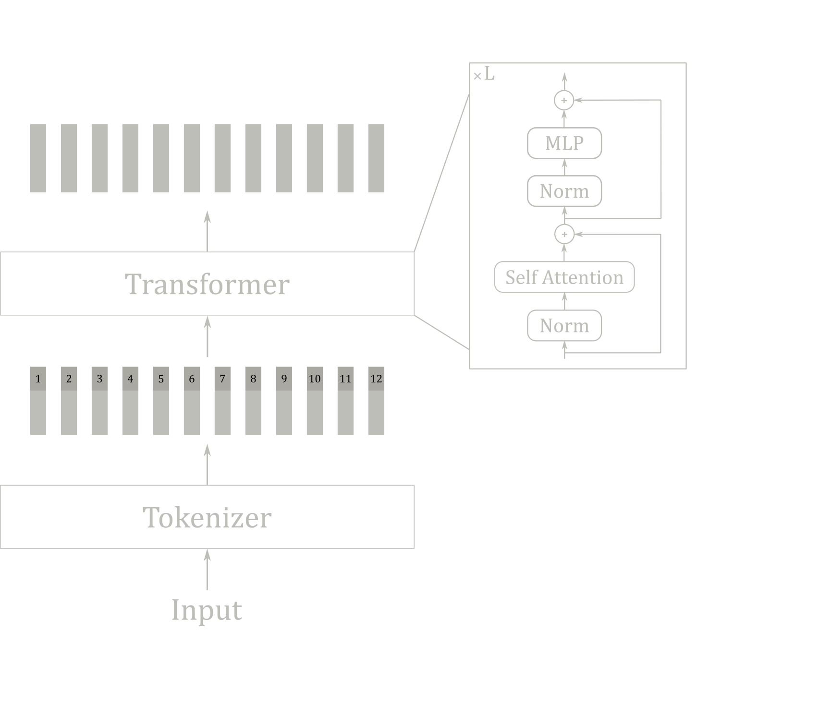
Method
Transformer generated by a transformer

Slide 9




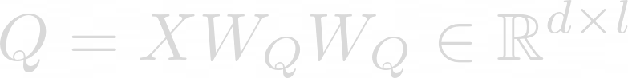



Method
Attention
Self-Attention

Slide 10
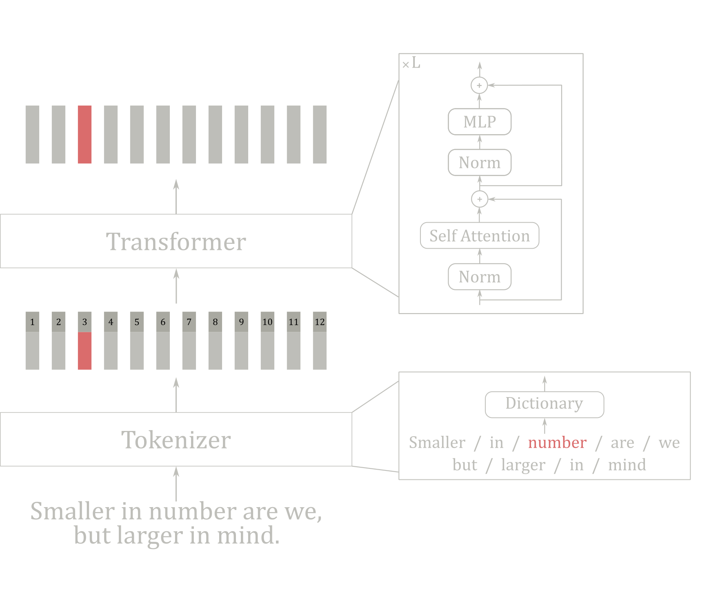
Method
Transformers in NLP

Slide 11
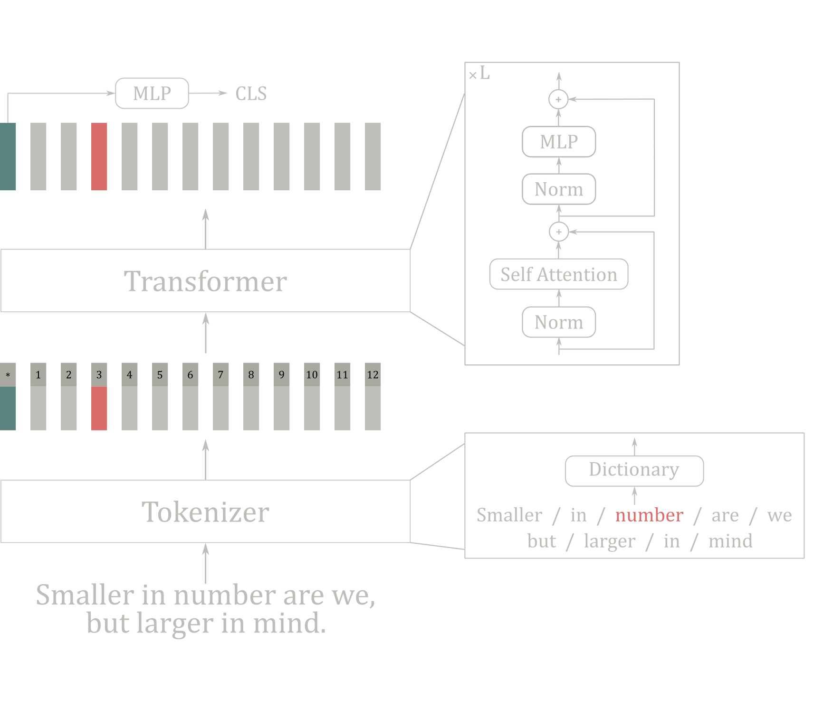
Method
Transformers in NLP

Slide 12
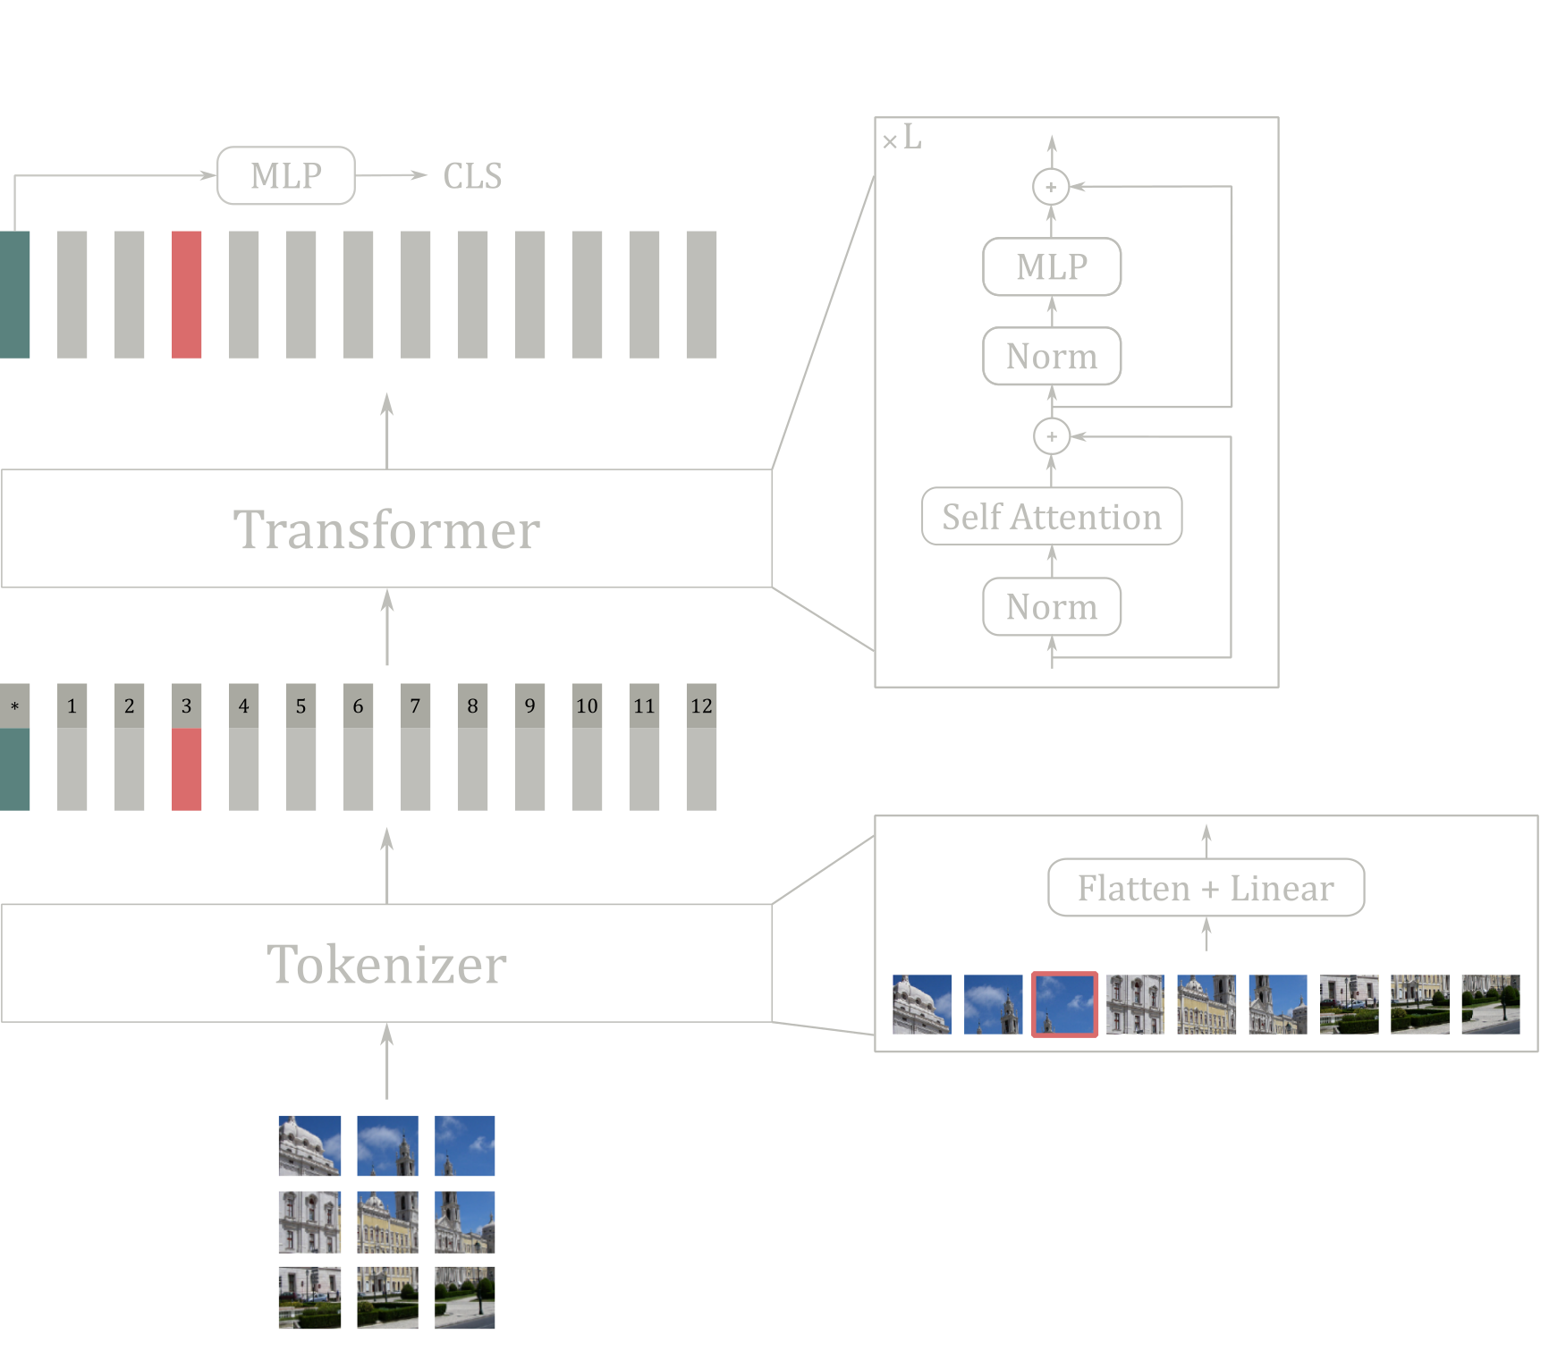
Method
Transformers in CV

Slide 13
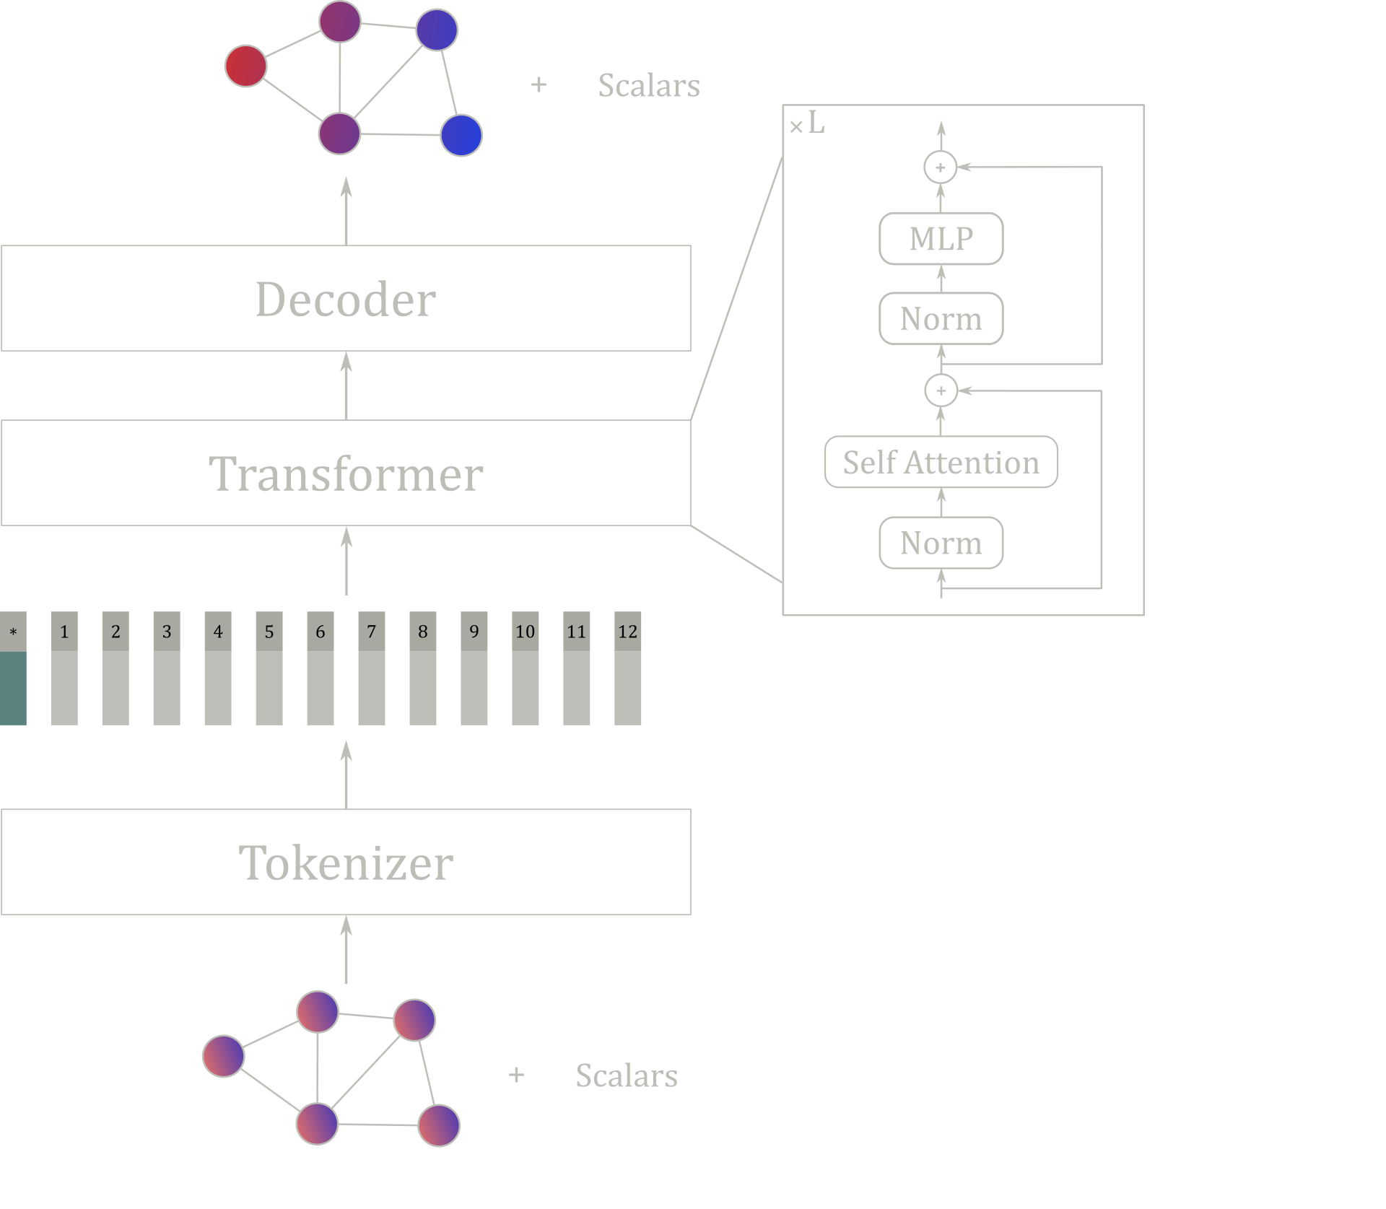
Method
Transformers on meshes?

Slide 14
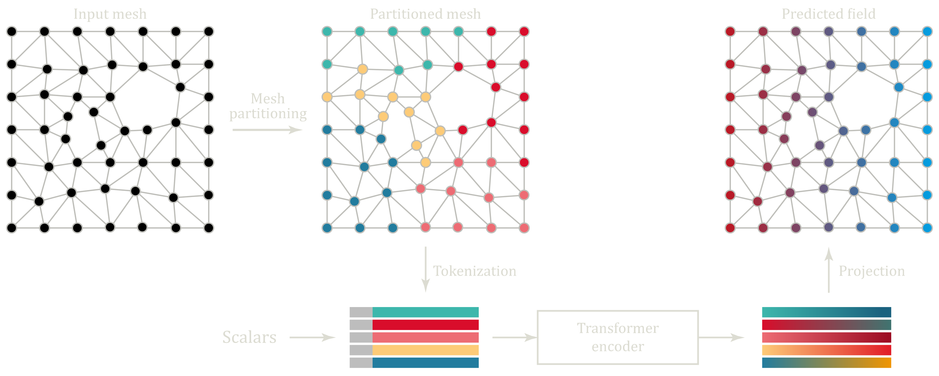
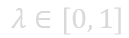
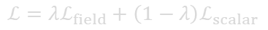
Method
Perte de rythme
ViT for meshes
Features
Position (x, y, z)
SDF
Vector to the closest border
Training loss
$$ℒ=λℒ_{field}+\left(1−λ\right)ℒ_{scalar}$$
$$λ∈\left[0, 1\right]$$

Slide 15
Experiments
ViT for meshes
Questions
Patch regularity
Order of nodes within each patch?
Cross-sample partitioning consisitency (relative position of patches)?
Shape of patches?
Positional encoding?

Slide 16
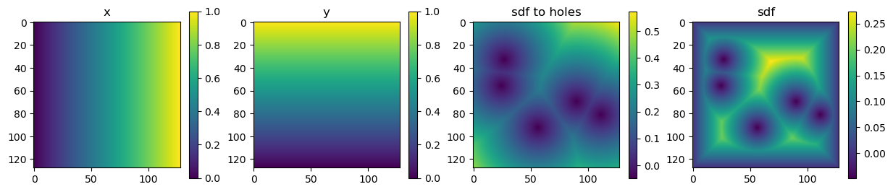

Experiments
Patch regularity?
Mesh → image
Powerful mesh processing with Muscat

Slide 17
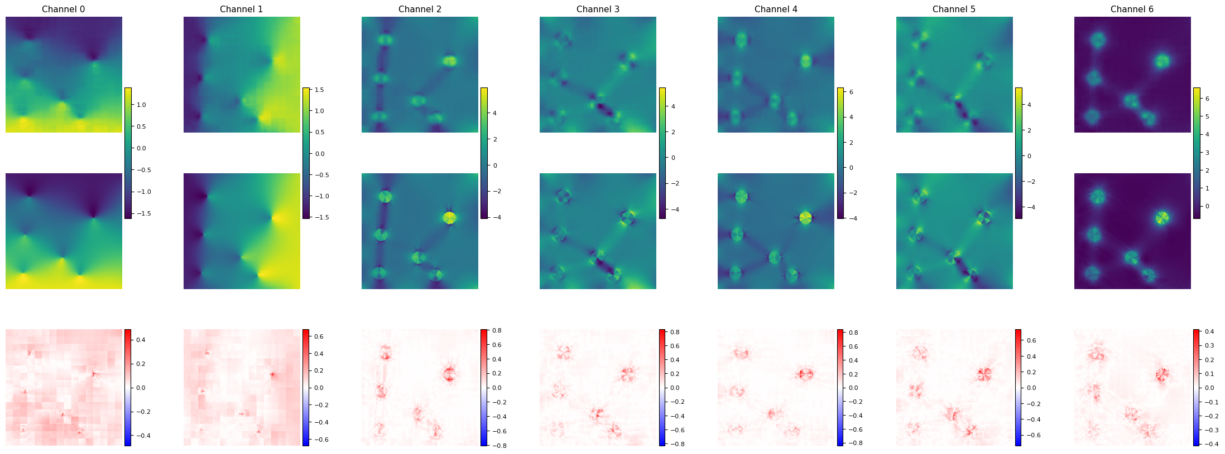
Experiments
Patch regularity ✅
ViT with 2D patch PE

Slide 18
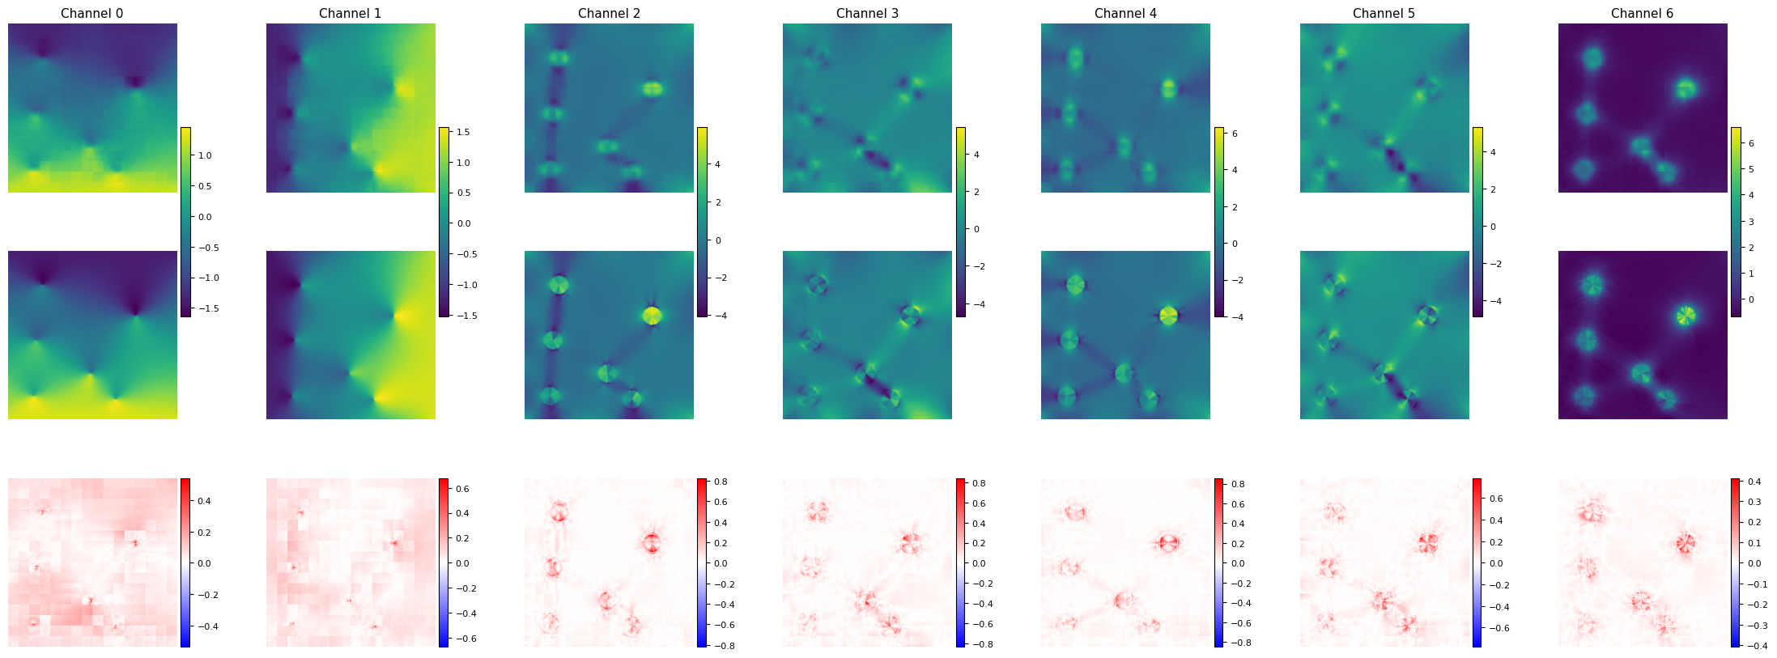
Experiments
Positional encoding ❌
ViT with 2D patch PE

Slide 19
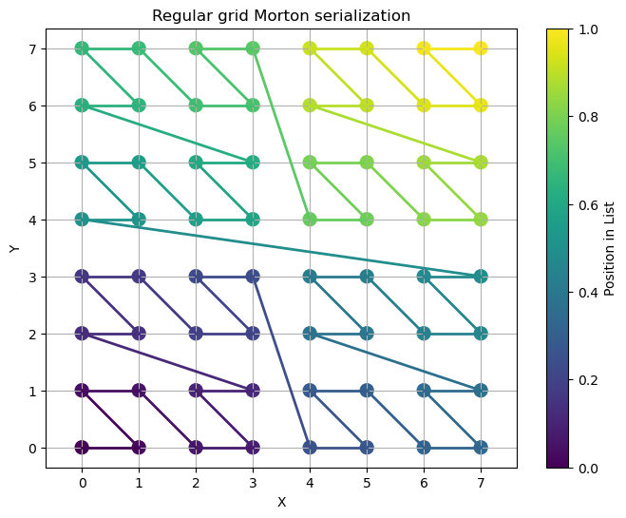
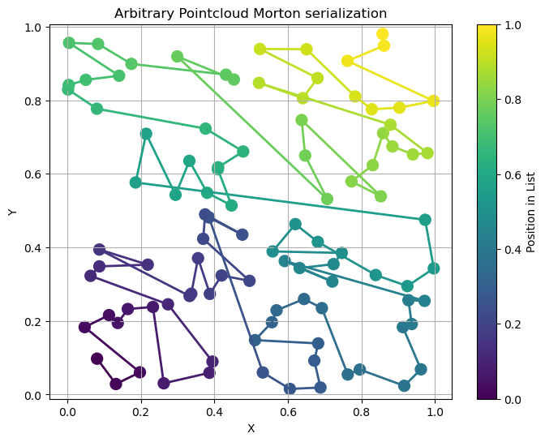
Experiments
Order of points within each patch?
Morton ordering

Slide 20
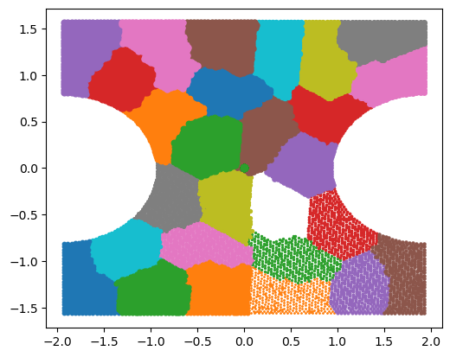
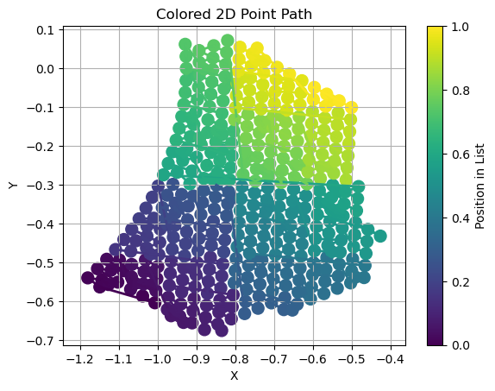
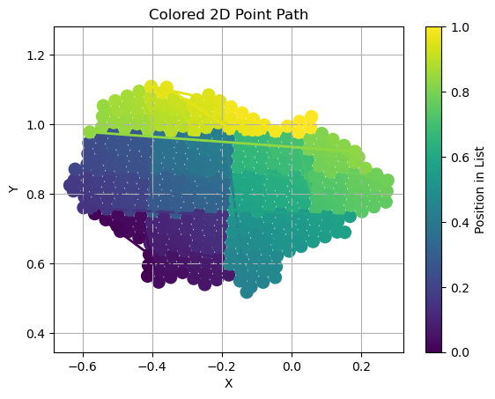
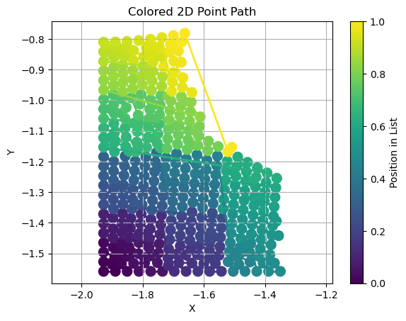
Experiments
Order of points within each patch?
Morton ordering
Optimal Transport
For clustering (assign mesh nodes to another’s mesh nodes
Tensile2d partitioned mesh
Optimal Transport for node ordering

Slide 21
Experiments
Order of points within each patch ✅
Parameter | Ordering
 | Random | Morton
U1 | 0.0254 | 0.0199
U2 | 0.0257 | 0.0233
Sig11 | 0.0555 | 0.0430
sig22 | 0.0282 | 0.0235
sig12 | 0.0424 | 0.0356
max_von_mises | 0.0186 | 0.0155
max_U2_top | 0.0327 | 0.0311
max_sig22_top | 0.0029 | 0.0029
total_error | 0.0290 | 0.0244
Morton ordering
Parameter | Value
Layers | 8
Latent dim | 512
Dim ff | 256
Activation | GeLU
Patch size | 10
Hyperparameters
Patch ordering results: -15%

Slide 22
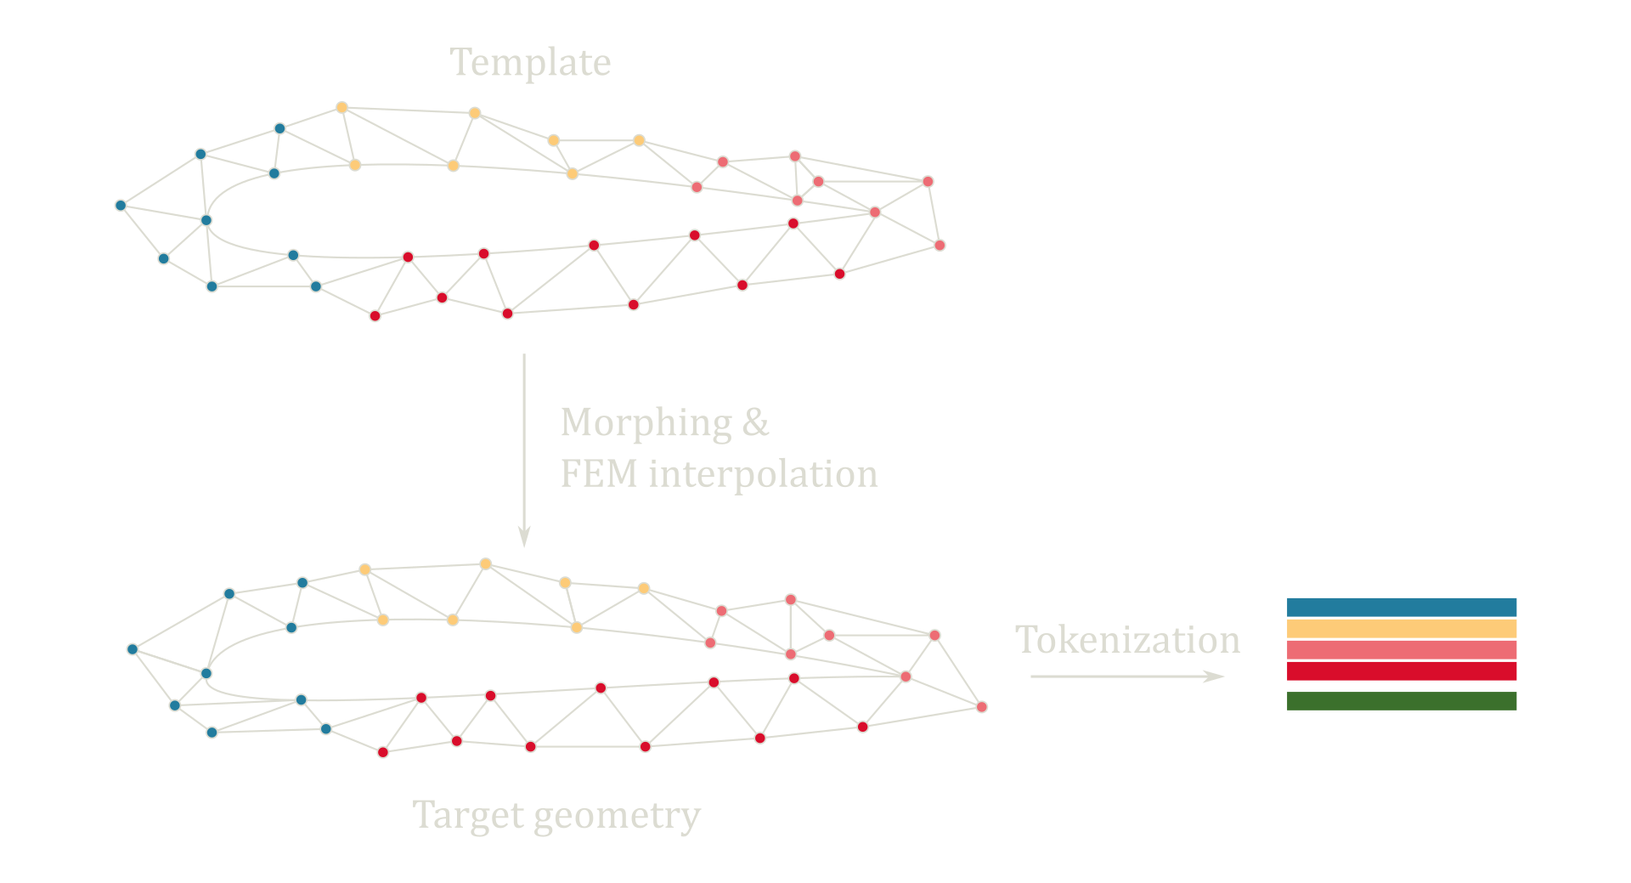
Experiments
Cross-sample partitioning consistency?
MMVT (Mesh Morphing Vision Transformer)

Slide 23
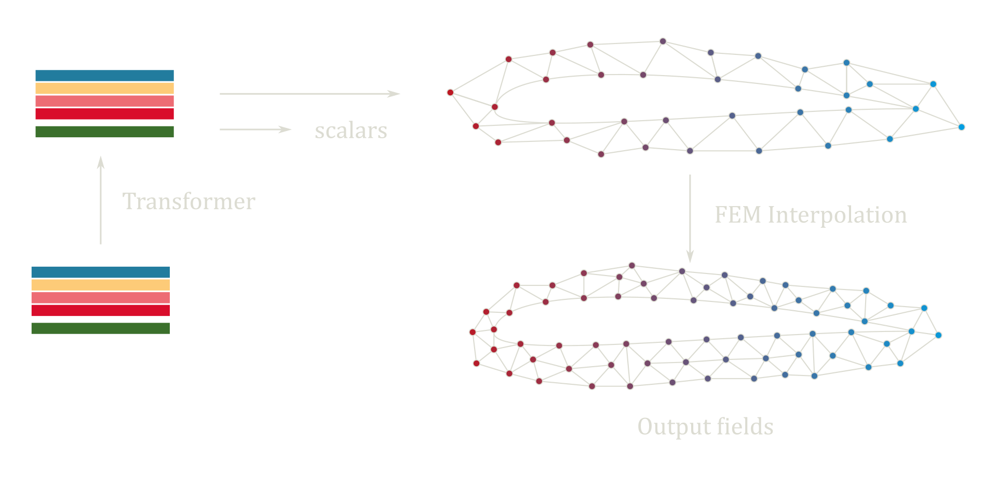
Experiments
Cross-sample partitioning consistency?
MMVT (Mesh Morphing Vision Transformer)

Slide 24
Experiments
Cross-sample partitioning consistency ✅
Parameter | Method
 | Baseline | MMVT
U1 | 0.0255 | 0.0168
U2 | 0.0257 | 0.0176
Sig11 | 0.0555 | 0.0412
sig22 | 0.0282 | 0.0209
sig12 | 0.0424 | 0.0315
max_von_mises | 0.0186 | 0.0148
max_U2_top | 0.0327 | 0.0180
max_sig22_top | 0.0029 | 0.0023
total_error | 0.0290 | 0.0204
MMVT (Mesh Morphing Vision Transformer)
MMVT results: -30%

Slide 25
Experiments
Results
Patch regularity
Order of nodes within each patch ✅
Cross-sample partitioning consisitency (relative position of patches) ✅
Shape of patches 🤔
Positional encoding ❌ on this simple test
To be continued…
Decoder improvement
Morphing of patches
Further testing the effects of PE on more complex problems

Slide 26
POWERED BY TRANSFORMERS

